Slide 1

3D Puzzle 3D printing algorithms course
Roy kinamon & alon mendelson

Slide 2
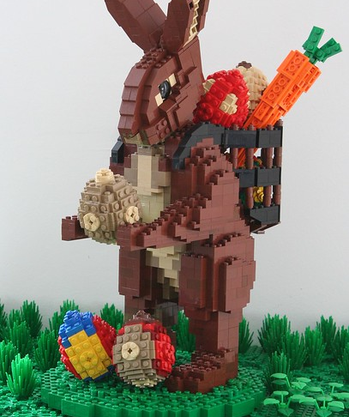
Outline and Motivation
Motivation
gain experience with 3D algorithms coding and hands on 3D printing
Outline
Input: 3D body for print
Output: Set of 3D printable puzzle pieces:
Built into original shape
Maintain stability and strength
Efficient run time and easy printing

Slide 3

Previous work in the field
Automated approaches for optimizing LEGO constructions (Primarily 2D)
Bricker - a blender extension converts any 3D Mesh into a photo-real 3D brick model
Chopper: Partitioning Models into 3D-Printable Parts

Slide 4
Our work
Most of previous work is limited per our design target as most either
Use Lego existing of shelf parts to build an approximate design target
Minimal partitioning to fit printer size
As such we have developed all code and algorithms from scratch

Slide 5
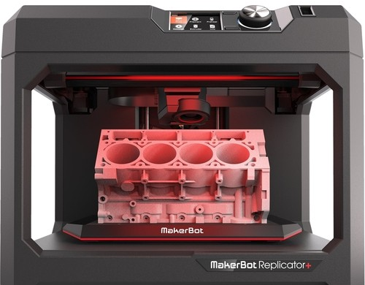
Framework
3D representation and manipulation
Trimesh
Blender and OpenScad (for Boolean operations)
Printing
MakerBot Replicator
Technology Price
FDM ~2000$
Build volume
29.5 X 19.5 X 16.5 CM
Layer Resolution
100 micron

Slide 6
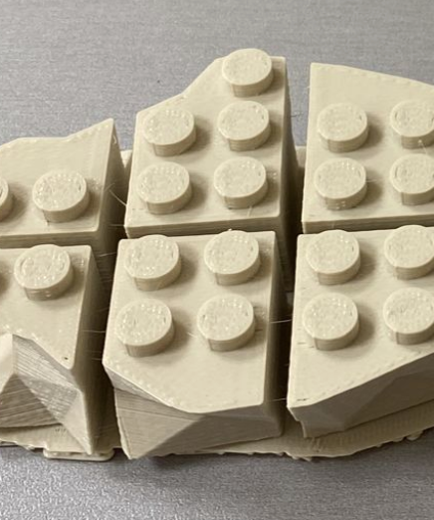
Algorithm stages – Slicing along Z
We find a slicing that fulfills the following constraints:
Slice height in some range
cross section above minimal area (not too small)
continuity in xy plane (slicing doesn’t separate model to parts)

Slide 7
Algorithm stages – bolts and voids (בליטות וחורים)
We create a grid of bolts and voids within the model bounding box.
Grid is defined by bolts radius and distance between bolts
We represent the slices with a Boolean grid of contained bolts and voids.

Slide 8
Algorithm stages – Plan X-Y Slicing
Recursive algorithm with greedy approach. runs on the Boolean representation with constraints:
Pieces not too big and not to small
Strong connection to adjacent layers
No overlapping cuts between adjacent layers
Represent slicing as binary tree

Slide 9
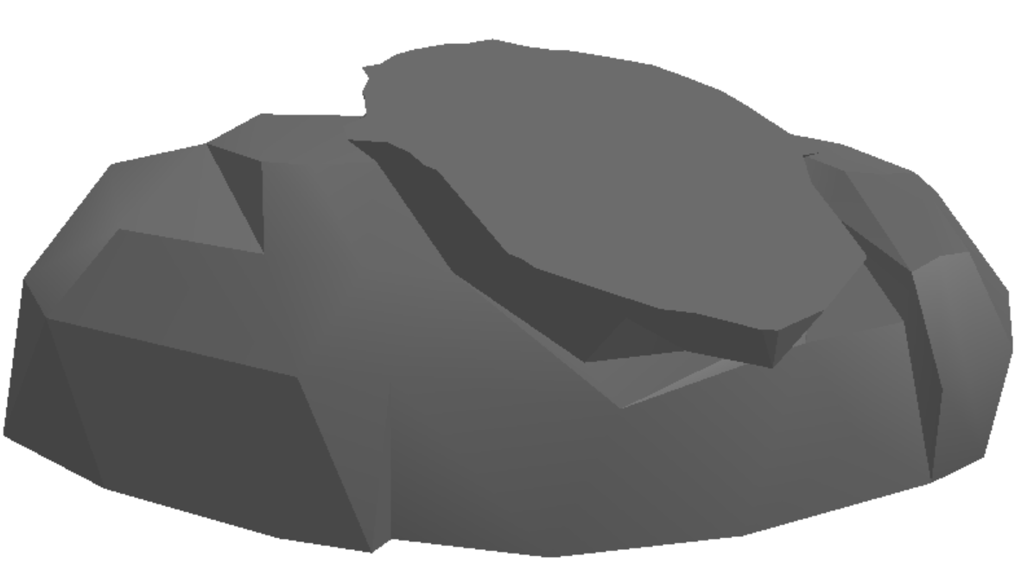
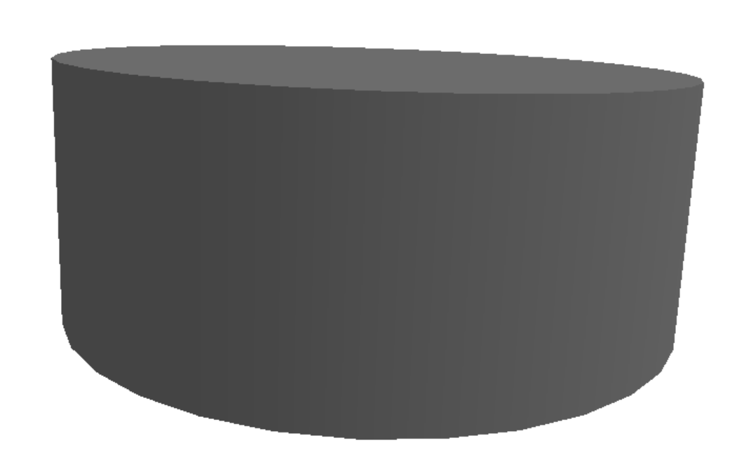
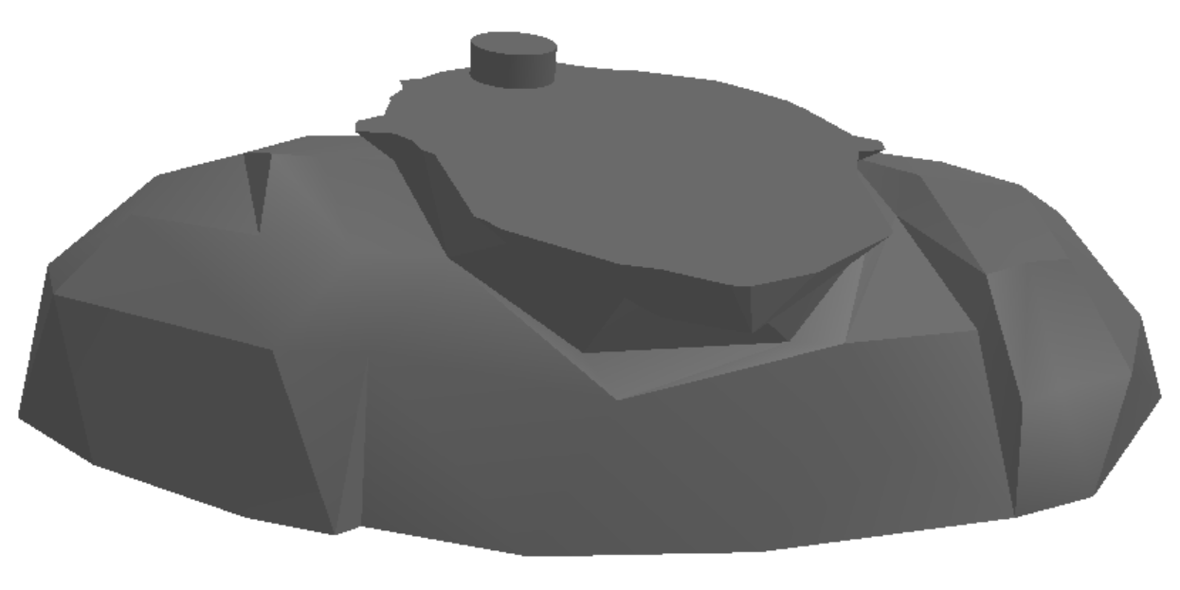
Algorithm stages – Add Bolts and Voids and slice
Add the bolts and the voids to each layer using Boolean operations
Perform slicing of the model along x-y with recursive algorithm operating on the binary tree

Slide 10
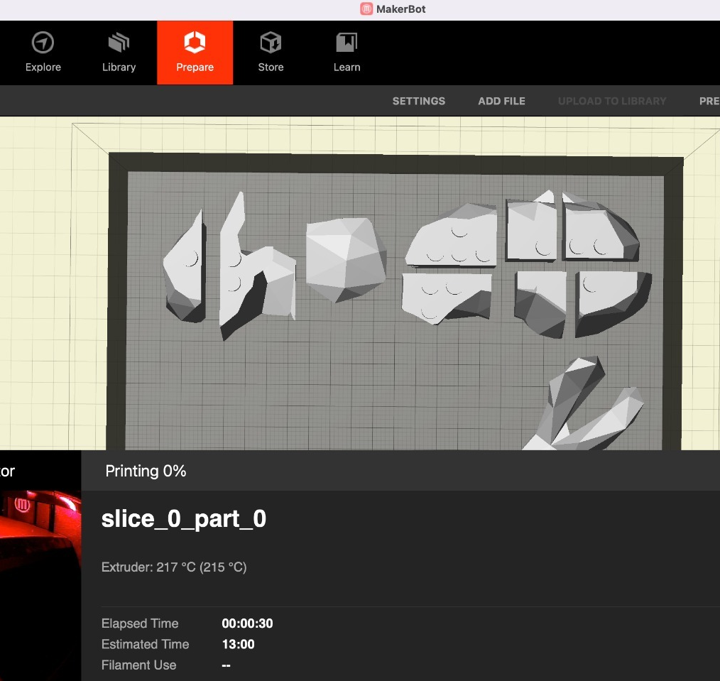
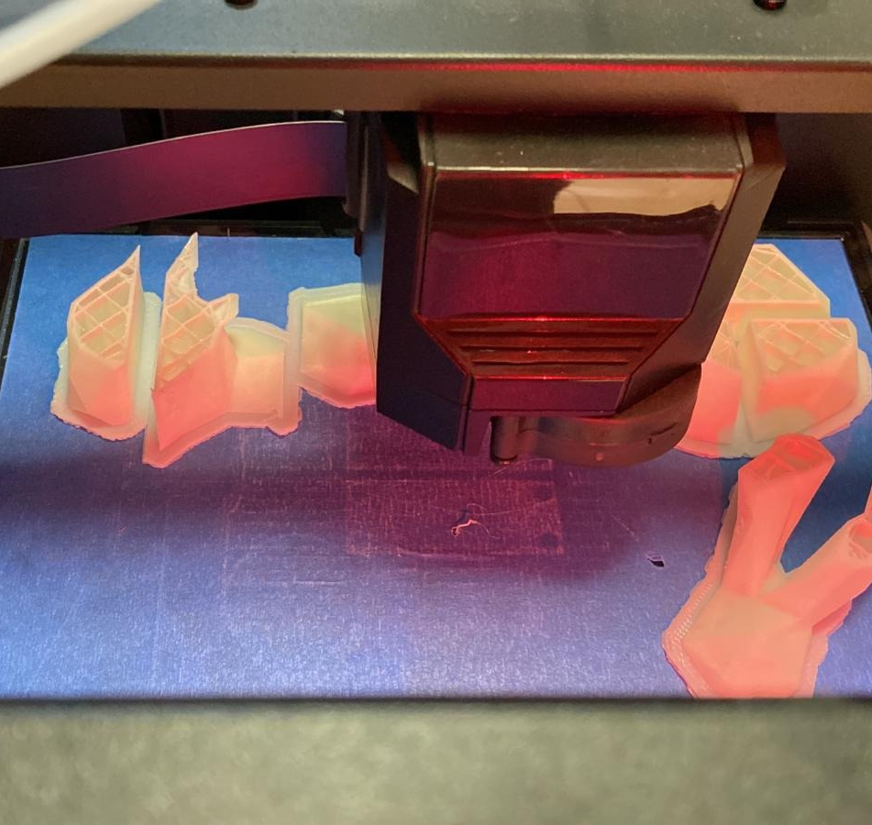
Print initial model with MakerBot replicator

Slide 11
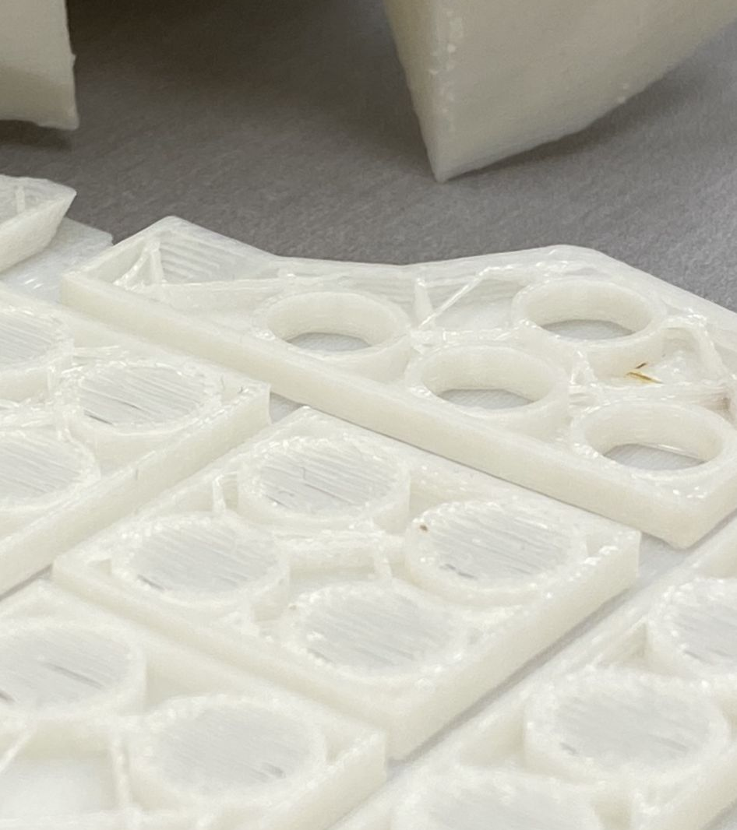
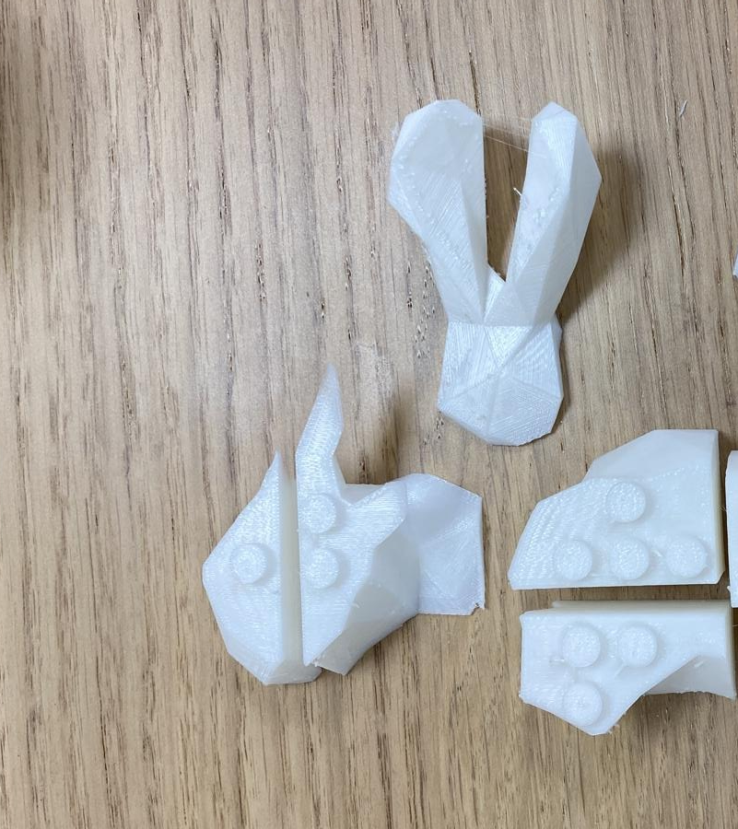
Bolts and voids Fine Tuning
First printed model was hard to assemble – pieces didn’t attach easily
Requires to adjust bolt and voids dimensions for ease of assembly but MakerBot resolution is low
We tried many different dimensions to find the best fit that:
Maintains physical strength
Pieces attaches and detaches easily

Slide 12
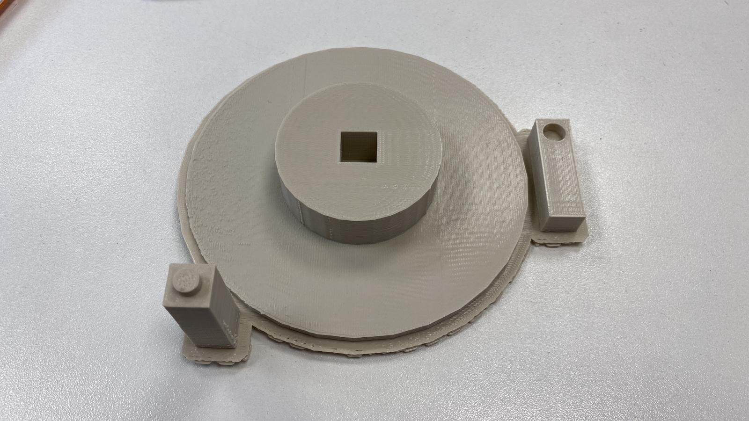
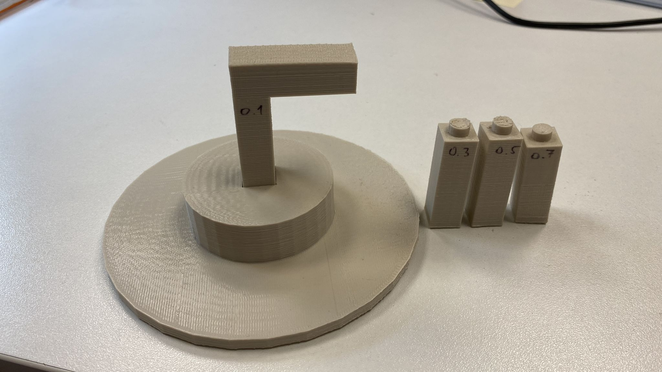
Optimizing Structure strength
P
d_{xy}
Measuring strength of single bolt over moment
Calculate total structure length and siameter
Trial 1 – make it stand - aborted
Filling
Shape
Trial 2
Modifying bolt dimensions from friction to
breaking pressure / flexural strength
h_{xy}

Slide 13
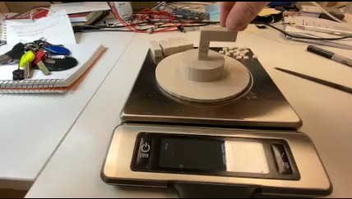
Testing Bending moment
Optimizing Bolts and Voids Daimeter and height
Optimizing printer parmaeters per part:
Layer height
Infill density
Infill Pattern
No. of shells
roof/Floor Thickness
For example at 0.1mm, 10%, Diamond, 2, 0.8mm ->
Breaking point at 40N with 2.5cm result in:
1Nm breaking moment

Slide 14
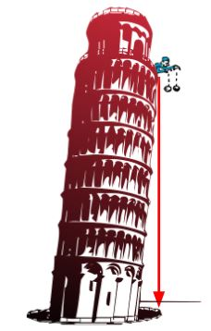
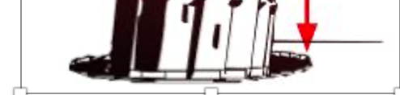
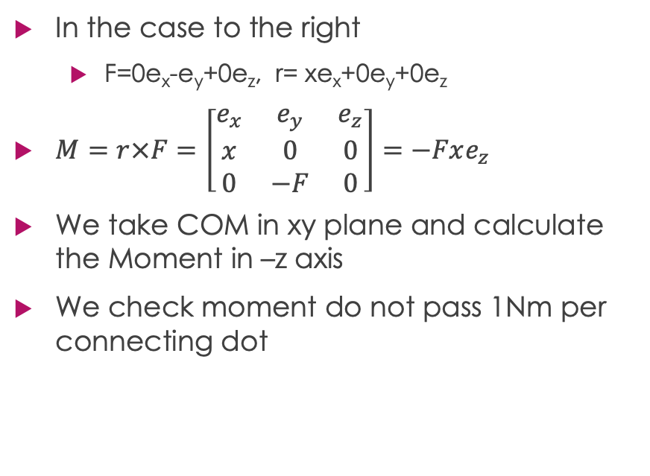
Adjusting strength
y
In the case to the right
F=0e_{x}-e_{y}+0e_{z}, r= xe_{x}+0e_{y}+0e_{z}
$M=r×F=\left[\begin{matrix}e_{x} & e_{y} & e_{z} \\ x & 0 & 0 \\ 0 & −F & 0\end{matrix}\right]=−Fxe_{z}$
We take COM in xy plane and calculate the Moment in –z axis
We check moment do not pass 1Nm per connecting dot
x

Slide 15
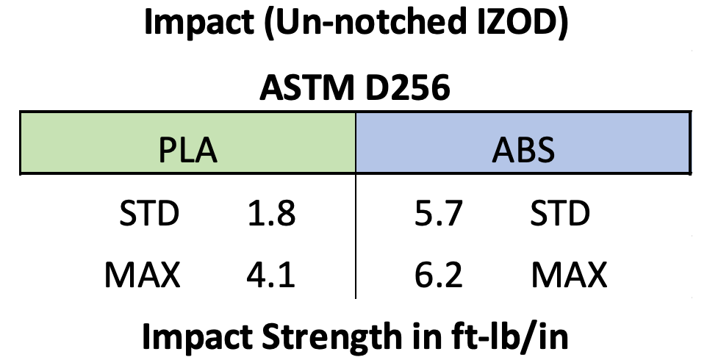
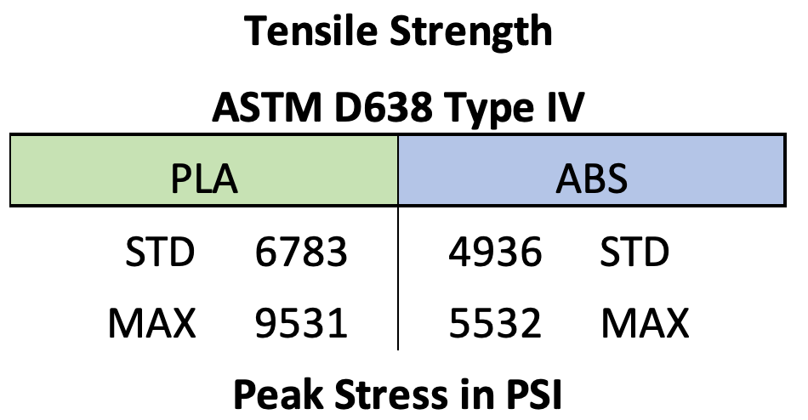
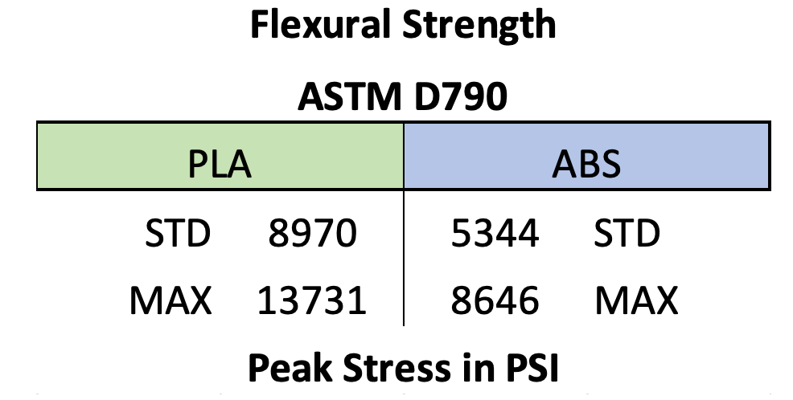
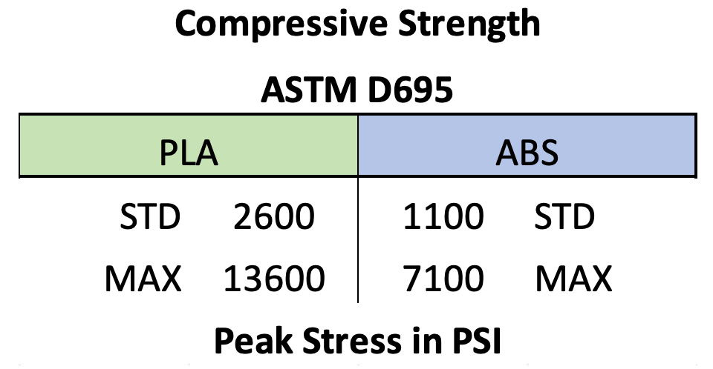
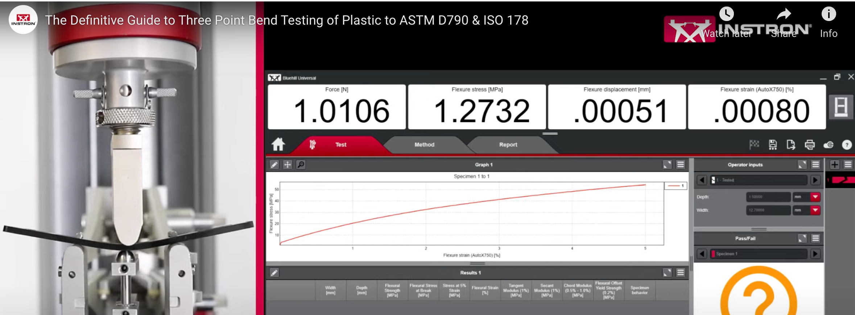
Optimizing Structure strength
Increase height and break resistance
Infill (Higher infill for a stronger part)
Shells (More shells for a stronger part)
Print orientation, size or design
Increase diameter of bolts till meeting flexural strength

Slide 16
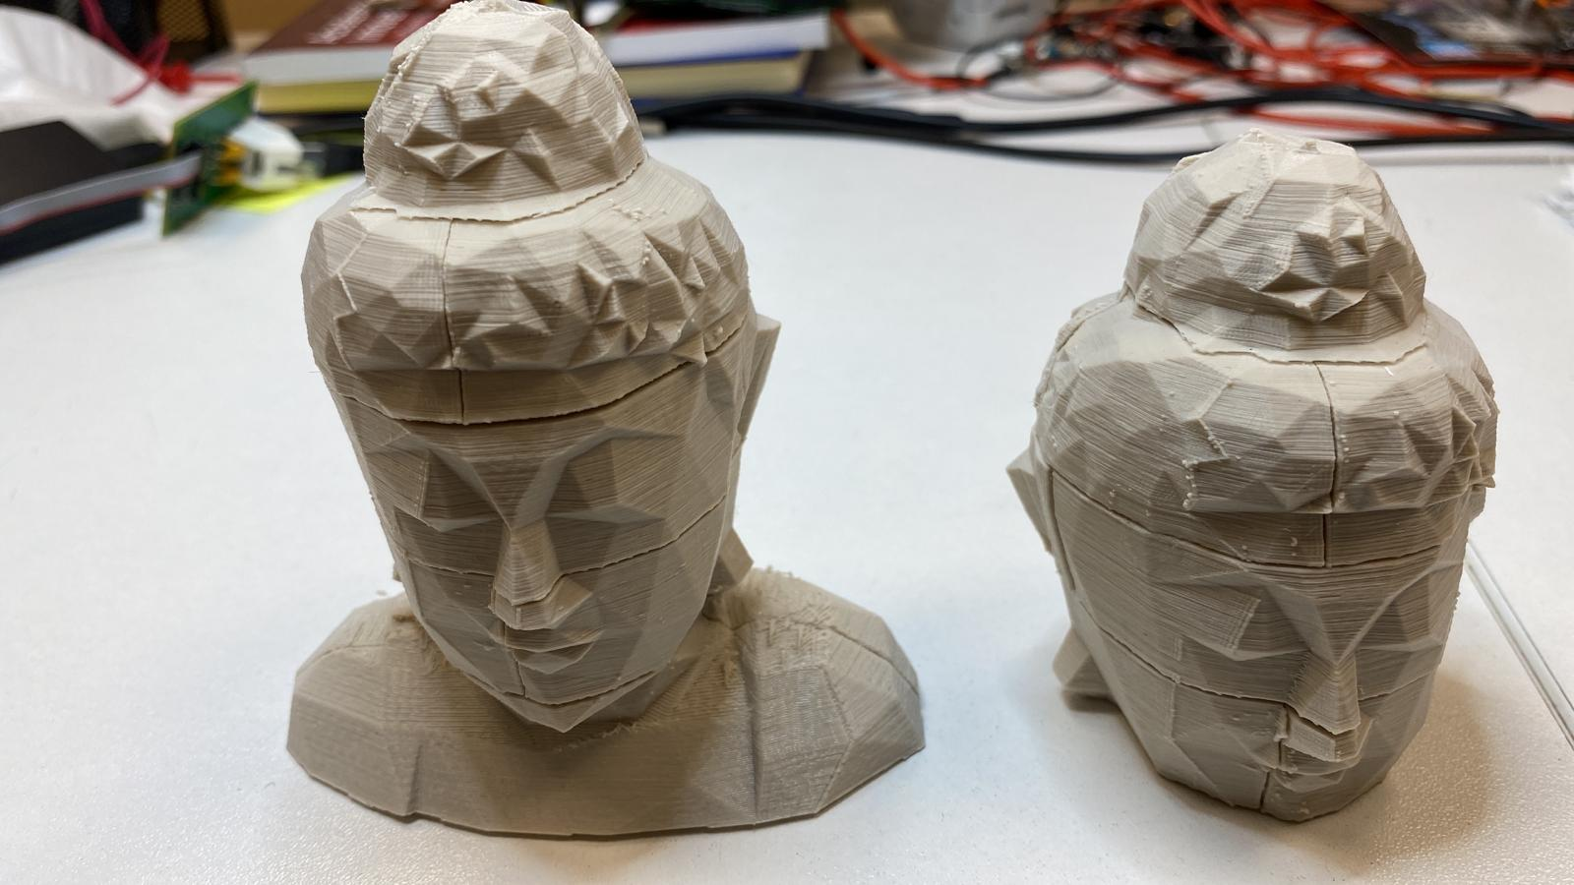
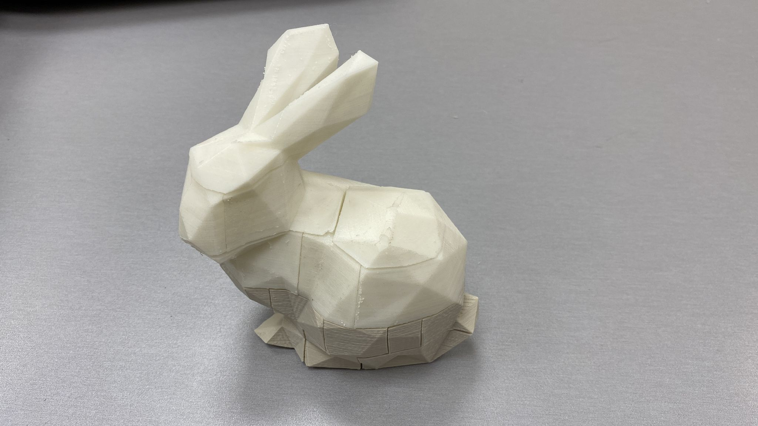
Results
Budha
Bunny
Print time (hours) | Algo runtime (mins) | No. pieces | Bounding Box (cm)
~11 | ~3 | 12 | 10X5X12 | Budha
~17 | ~7 | 23 | 10X6X13 | Bunny

Slide 17
Challenges
Trimesh and Blender are unstable
Transition to OpenScad
Printing
Alignment and Calibration
Quality
Duration
“Debugging” is costly

Slide 18

Thank You

